Slide 1
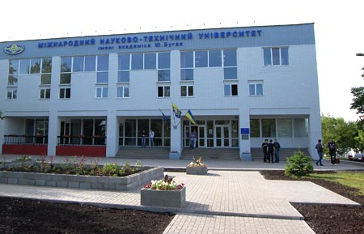

Higher private educational establishment Yuriy Bugay International Scientific and Technical University
(ISTU)
Kyiv, Ukraine
Established in 1993 www.istu.edu.ua
Кyiv, 2017

Slide 2
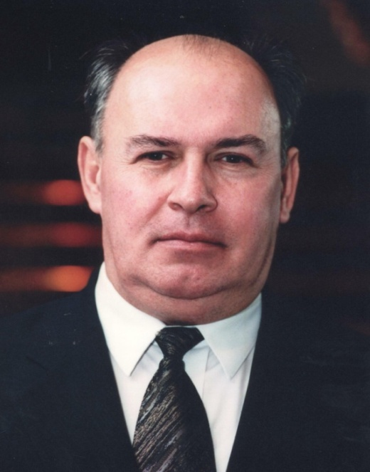
The first President of ISTU
Bugay Yuriy
Mykolayovych
(1947-2003)
Doctor of Technical Science (1985)
Professor (1988)
Academician of the Mining Sciences Academy (1991)
Corresponding Member of the Academy of Pedagogical Sciences of Ukraine (1999)
Full member of the International Academy of Higher Education (1995)
Honored Worker of Science and Technology of Ukraine (1998 ).

Slide 3
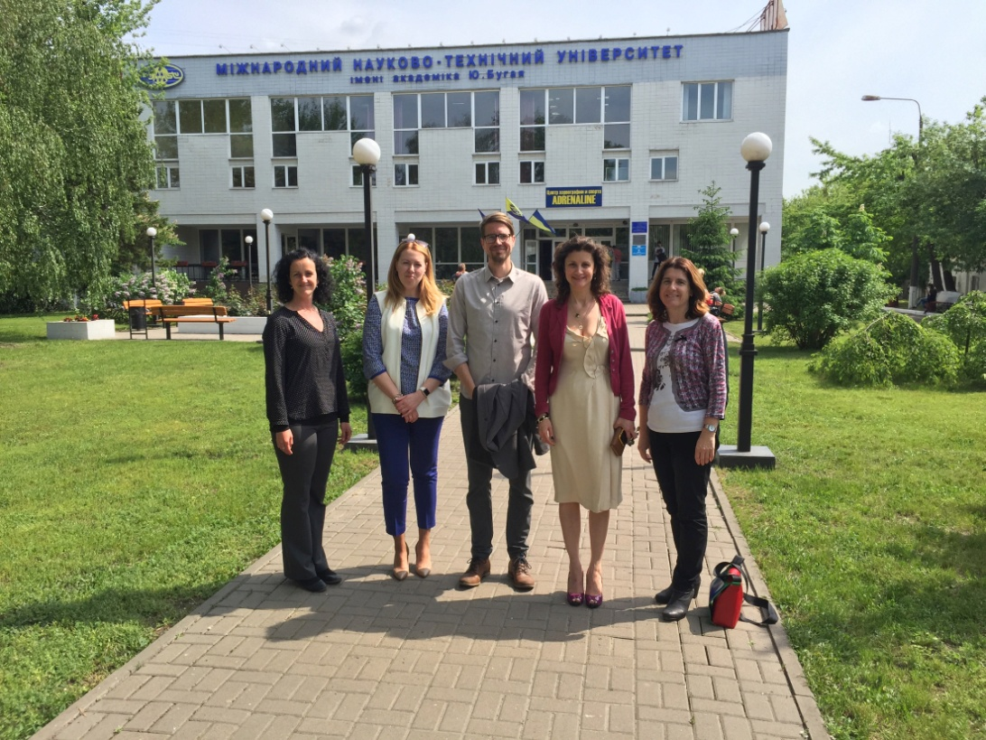
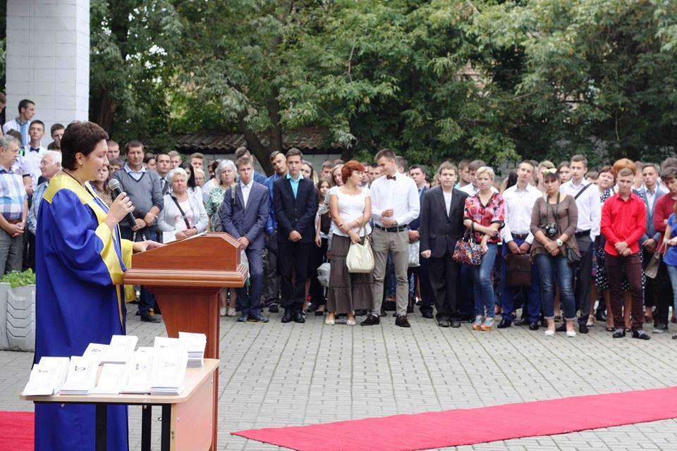
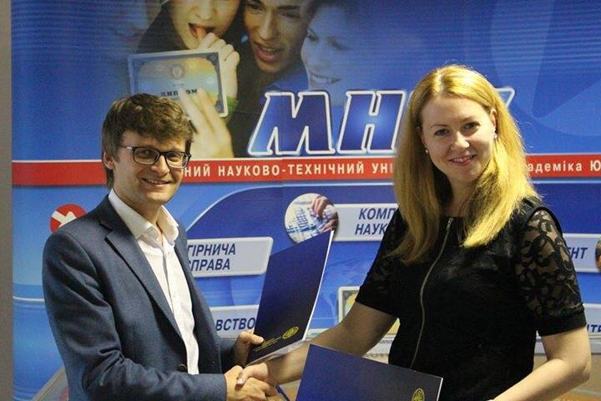
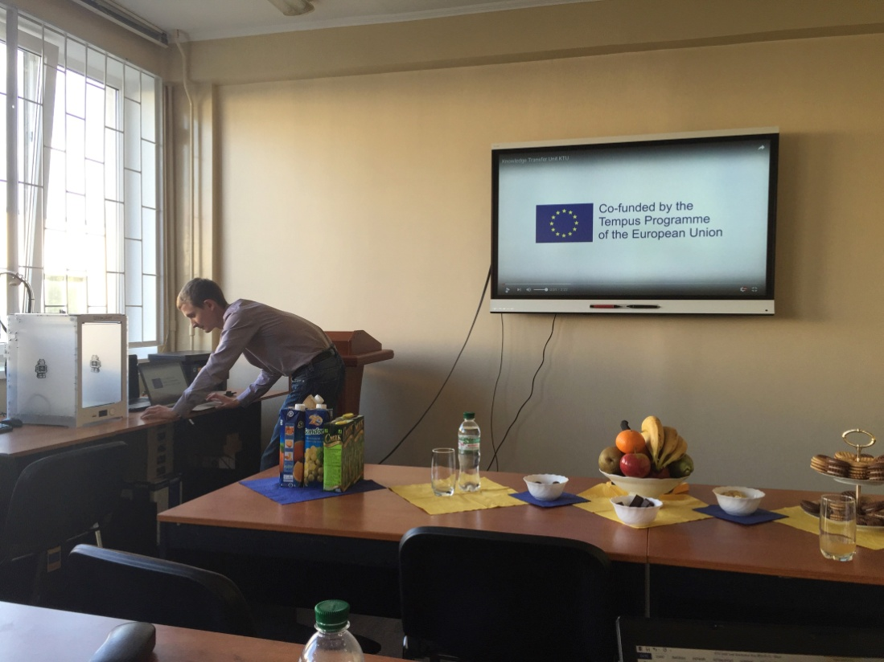

Slide 4

TODAY ISTU IS:
an educational and scientific organization that trains specialists in various fields of study: International Economic Relations, Economics, Management and Administration, Jurisprudence, Public Administration, Foreign Philology, Health Care and Environmental Protection, Physical Culture and Sports.
ISTU has:
4 Institutes in Poltava, Chernigiv, Kramatorsk, Lutsk;
3 Colleges in Poltava, Lutsk, Kyivю

Slide 5
ISTU MISSION:
High quality education in the technical, economical, financial and humanitarian spheres at the level provided by national and international educational standards.
Implementation of effective teaching technologies, development and promotion of the best practices of national and international higher education.
Ensuring graduates with the potential for integration into the global labor market.
Formation of the active public attitude among young people necessary for the further successful development of Ukraine and enhancement of the well-being of the Ukrainian people..
Formation of the outlook on the basis of humanitarian values.

Slide 6
ISTU DIRECTION OF ACTIVITIES:
Prepares Bachelor’s and Masters degrees in the following fields of knowledge: International Relations; Management and Public Administration; Jurisprudence; Health Care; Humanities and Natural Sciences; Production and Technology, including IT; Electronics and Telecommunications. Trains specialists majoring in Economics in PHD educational-scientific degree. Conducts fundamental and applied research in various scientific and technical fields (including production of oil and gas, etc.). Updates the curricula and modules for students and post graduate students in the direction of effective teaching technologies application. Participates in new methodological materials development; provides consultations in the field of higher education and introduction of modern practices, including integration into the European educational system for the development of national higher education space.

Slide 7
MAJOR SUBJECT AREAS FOR BACHELOR EDUCATIONAL LEVEL
Field of knowledge | Major subject area
Health Protection | Physical therapy, Ergotherapy (Physical Rehabilitation)
Humanities | Philology (English)
Jurisprudence | Legislation
International Relations | International Economic Relations
Management and Administration | Finance, Banking and Insurance
 | Accounting and Taxation
 | Management
Public Management and Administration | Public Management and Administration
Natural Science | Ecology
Production and Technology | Environmental Protection Technology
Information Technology | Computer Science
 | Software Engineering
Production and Technology | Oil and Gas Engineering and Technology
Electronics and Telecommunications | Telecommunications and Radio Engineering

Slide 8
MAJOR SUBJECT AREAS FOR MASTER EDUCATIONAL LEVEL
Field of knowledge | Major subject area
Humanities | Philology (English)
Jurisprudence | Jurisprudence
International Relations | International Economic Relations
Management and Administration | Finance, Banking and Insurance
 | Accounting and Taxation
 | Management
Public Management and Administration | Public Management and Administration
Information Technology | Computer Science
Production and Technology | Oil and Gas Engineering and Technology

Slide 9
ISTU numbers:
4000 students;
320 employees;
250 professor-pedagogical staff,
including:
33 Doctors of Sciences;
165 Candidates of Sciences.

Slide 10






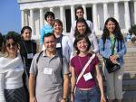

INTERNATIONAL ACTIVITY
Participation in the Cultural Exchange Program "WORK & TRAVEL USA" .
Participation in 6 European Union projects (TACIS, TEMPUS, currently Erasmus +). To date, two Erasmus+ Projects are being carried out.
"Information and Communication Technologies in Education“ UNESCO Chair. DAAD, CONCORDIA and FULBRIGHT internships and scholarship programs.

Slide 11
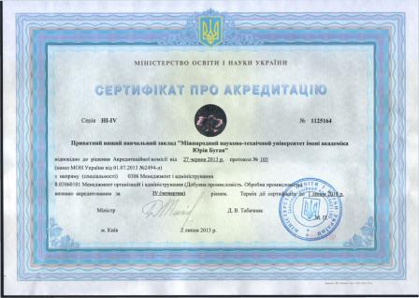
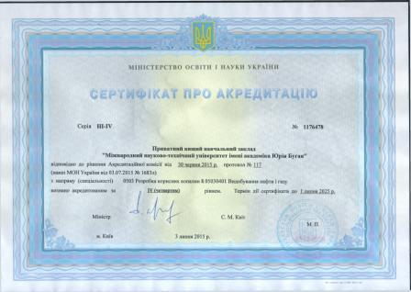
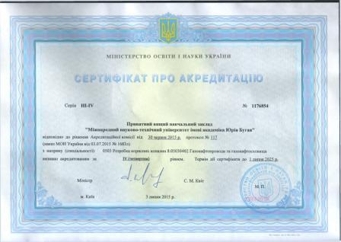
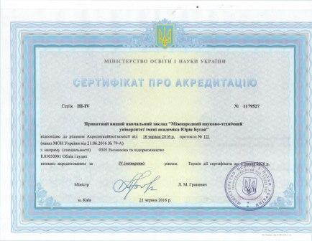
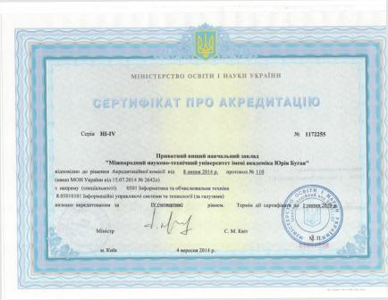
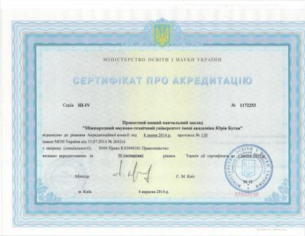
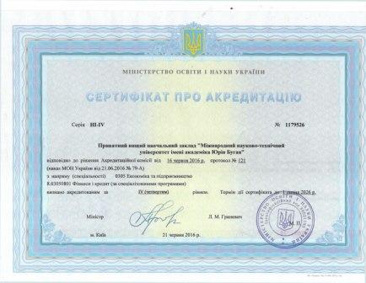
CERTIFICATES

Slide 12
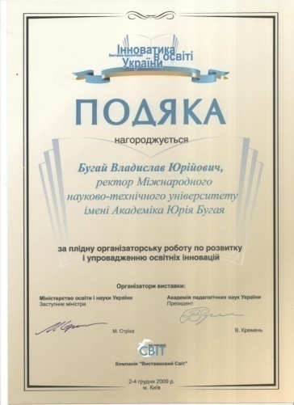

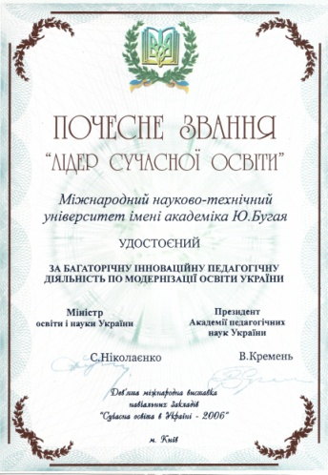
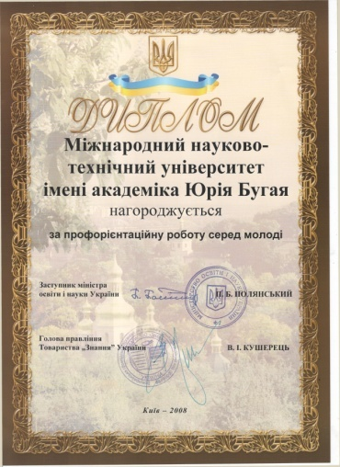
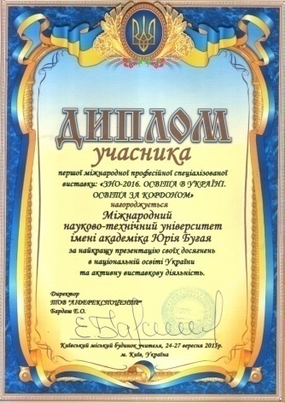
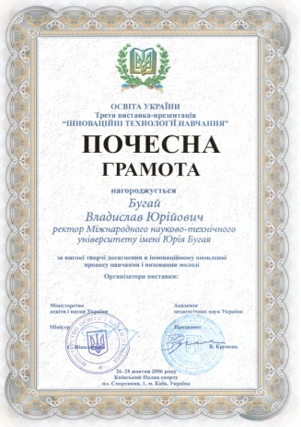
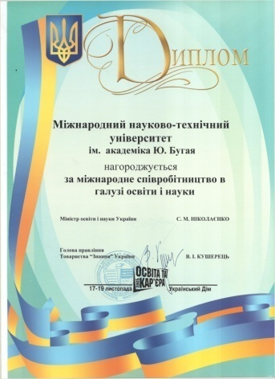
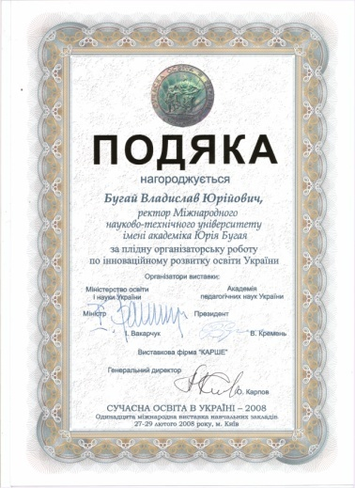
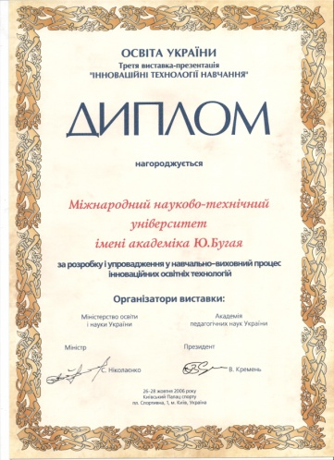
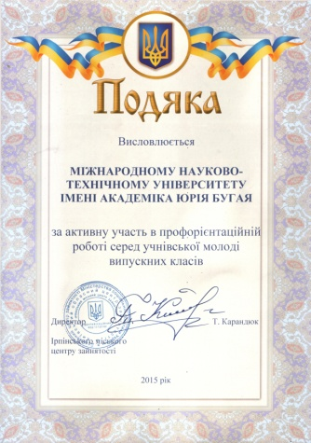
AWARDS

Slide 13
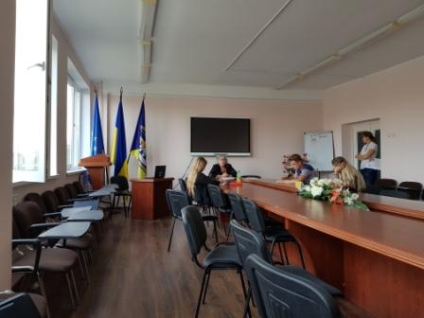
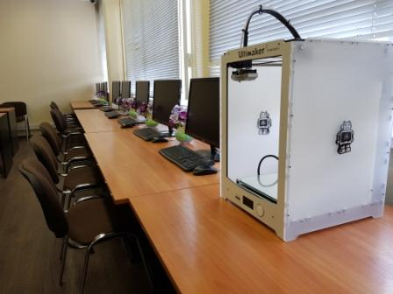
ISTU RESOURCE BASE
The training is conducted in:
well-equipped information centers, modern laboratories,
computer classes,
sport halls and gyms.

Slide 14
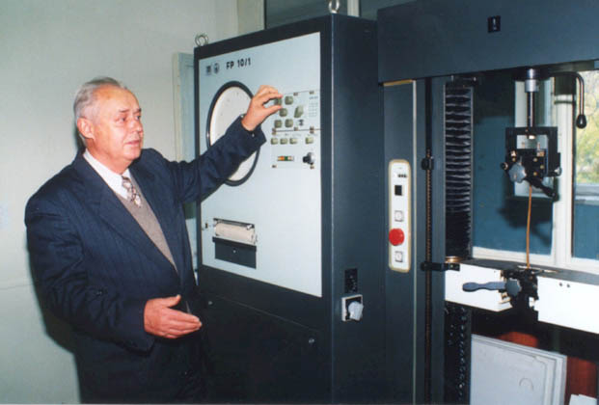
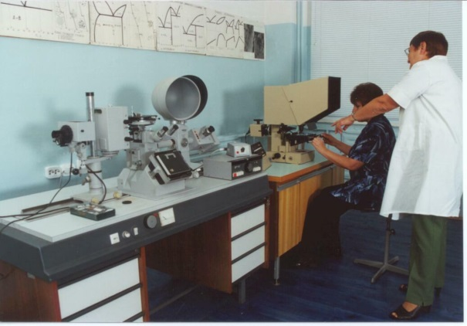
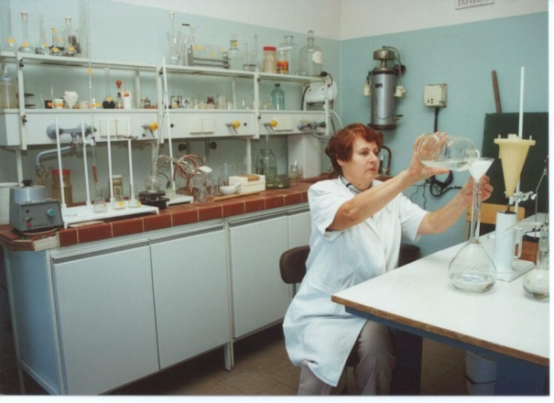
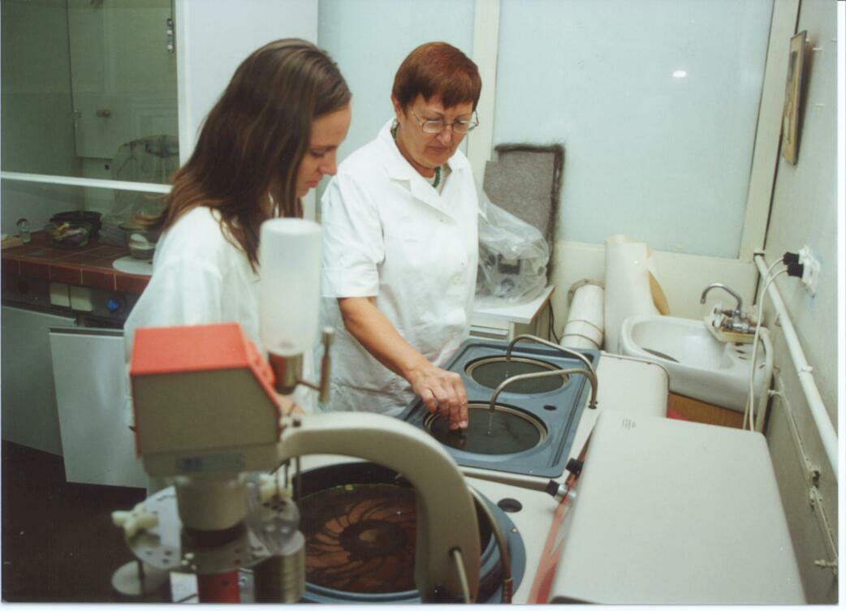
ISTU LABORATORIES
ISTU has
physical laboratory;
chemical laboratory;
material science laboratory;
environmental protection laboratory;
gas turbine plants and heat engineering laboratory;
laboratory of measurements.
Educational classes for students of oil and gas specialties are
upgraded with specialized equipment

Slide 15
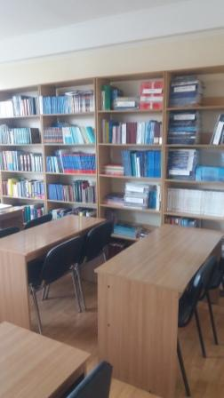
SCIENTIFIC LIBRARY
ISTU scientific library has about 10 thousand copies of textbooks and specialized publications, which are presented in paper and electronic catalogs.
The electronic library contains about 2 thousand full text of modern textbooks for students of all specialties of the University.
The English-language fund of the library is the largest among non-state higher educational institutions of Ukraine.

Slide 16
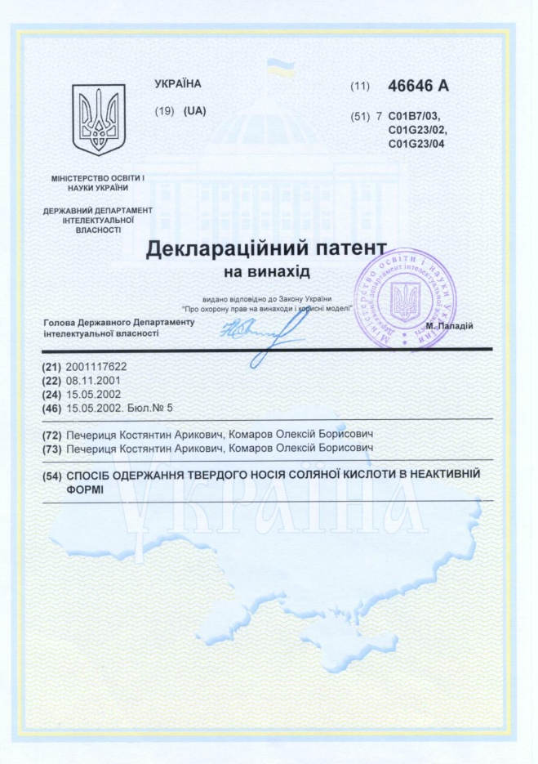
ISTU INTELLECTUAL PROPERTY
About 100 textbooks and 30 monographs have been ussued;
about 300 articles have been published in specialized journals;
49 declarative patents of Ukraine for the total amount of 26,270, 000 UAH (approximately 5,000, 000 Euro) have been developed and received.

Slide 17
Our contacts
Rector
Doctor of Economics Khudoley (Bugai) Veronika Yuryevna
tel. +38 (044) 559 24 33
e-mail: khudolei@ukr.net
Pro-rector for international projects
Doctor of Economics Ponomarenko Tatyana Vadymivna
tel. +38 (044) 559 24 33
+38 (098) 028 63 18
e-mail: tetyana.pon@gmail.com
www.istu.edu.ua
THANK YOU FOR CO-OPERATION

